Slide 1
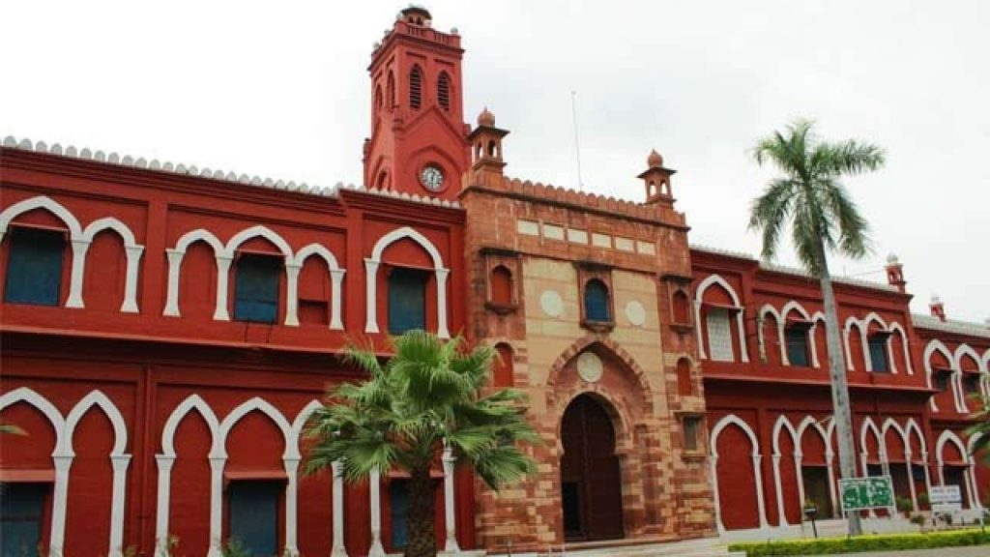

ANNUAL MAGZINE
Aligarh Muslim University
This Photo by Unknown Author is licensed under CC BY-NC-ND
This Photo by Unknown Author is licensed under CC BY

